Slide 1


Simone Biles

Slide 2
What has she won?
Simone has won 11 Olympic medals.
She’s won numerous world championships.
She was famous at 13 even though she didn’t qualify for the 2012 London Olympics.
She had 2 gold medals at the age of 16

Slide 3
Where has she lived over the years?
https://youtu.be/DzG_IMh7lgE
Click the video to see a short clip of her story.
She was born in 1997, she has three sisters and was adopted.
Simone went to school in Texas.

Slide 4
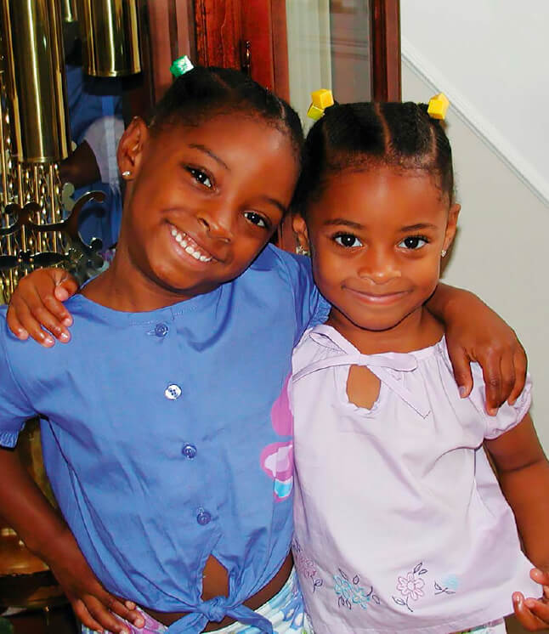
FUN FACTS
She is 27 years old
She grew up in Columbus
Simone is an American
She was born in 1997,on the 14 March.

Slide 5
Thank you for listening
BY THEO

